Slide 1
Response time vs. Environment
Devdhar Patel

Slide 2

Different response times in different environments
Agent

Slide 3
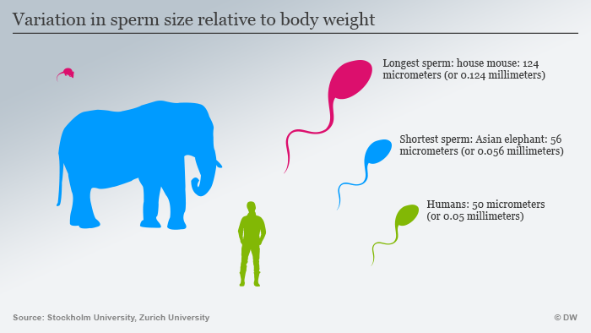
Different response times in different environments
The effects of gravity is felt differently at different sizes
The normalized speed of the body is also different at different sizes
This means that with the changing body size, the environment of the agent changes

Slide 4
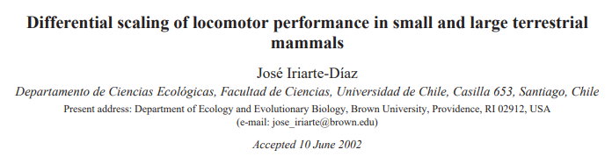
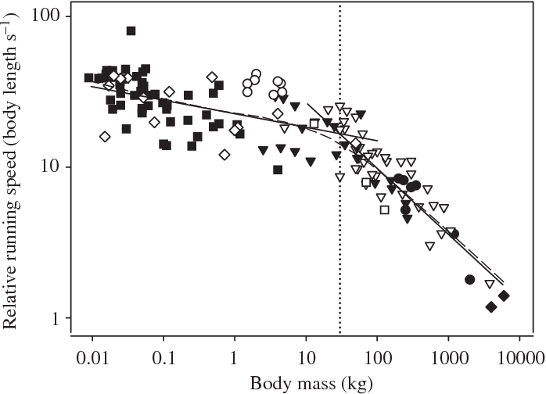
Due to the differential effects of gravity on small and large-sized forms, the relative speed negatively correlated with body mass
However, the exponential coefficient becomes a lot negative for mass > 30kg
Thus, in the same environment, different masses require different response speed for control

Slide 5

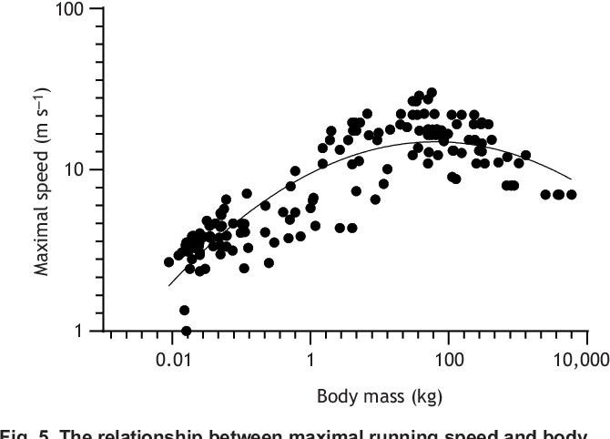
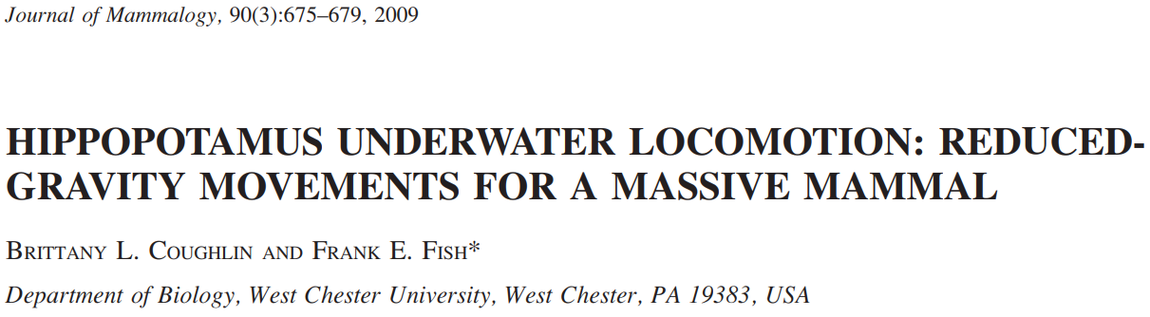
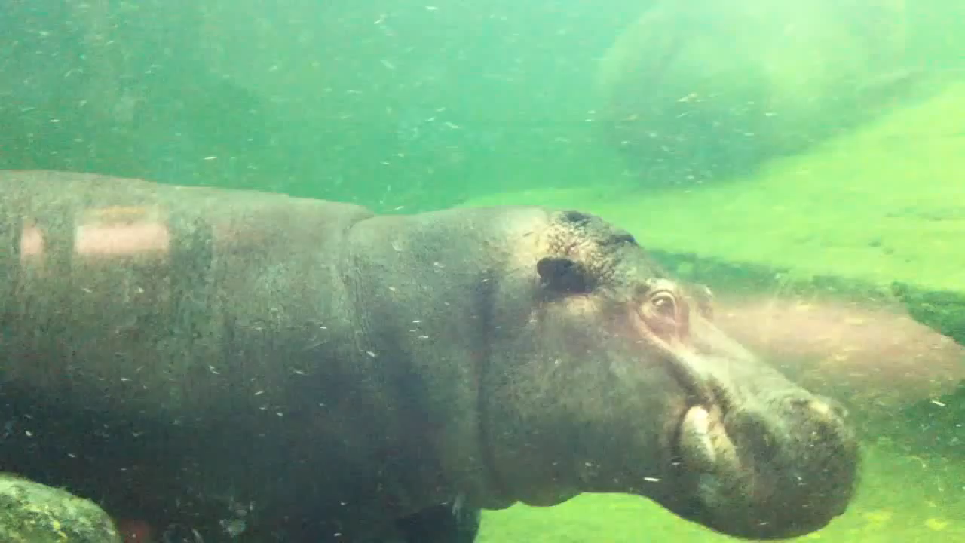
2021
As size increase, the motion behavior must change to account for the differential effect of gravitational forces on small and large body sizes
However, with a change in the environment, the motion changes:
Hippos gallop rather than walking in the reduced gravity underwater
Similarly, Under conditions of reduced gravity, humans switch from a walk to a run at slower speeds (Kram et al. 1997)
This might be the effect of same control frequency under different environments.

Slide 6
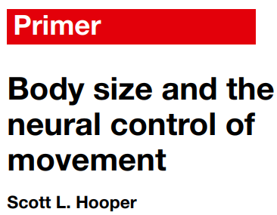
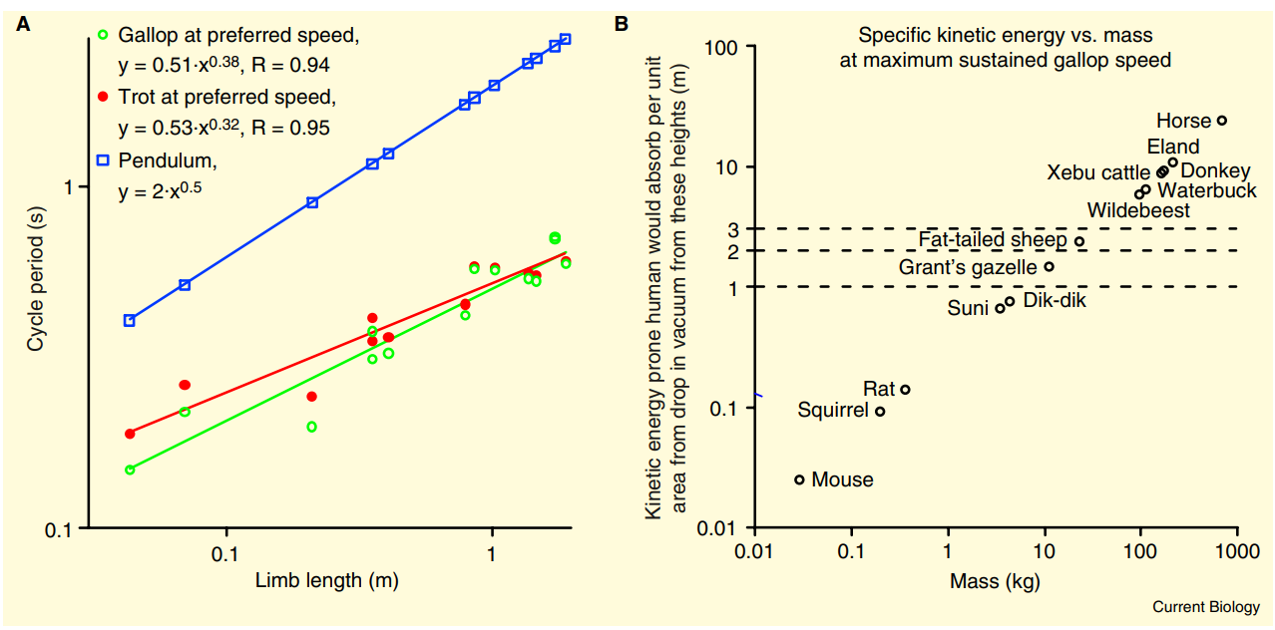
For large animals, the importance of gravity and momentum increases and passive muscle properties decrease with limb size, thus they should devote more neural resources to hazard avoidance
Limbs have shorter periods than pendulums of the same length

Slide 7

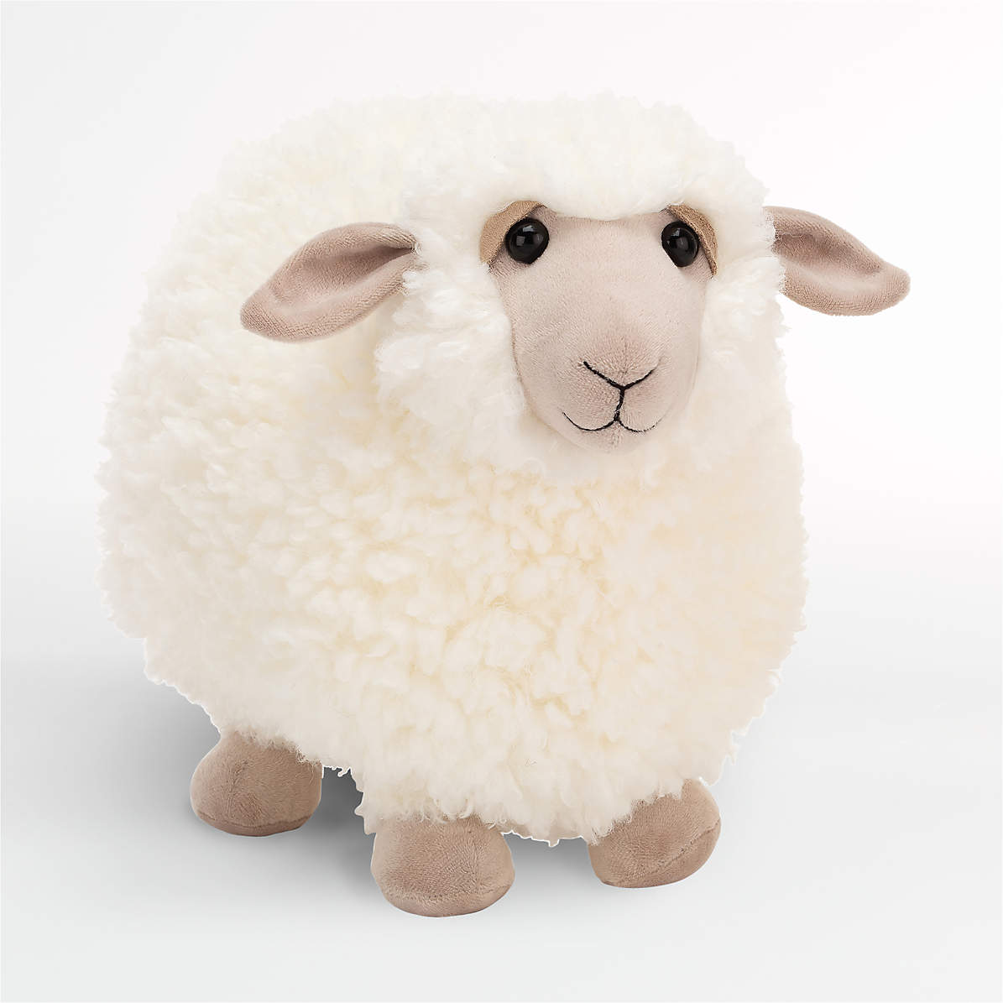
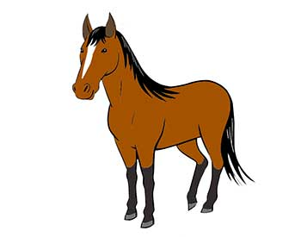
Small animals absorb inconsequential energies
Not running into walls matter more for horses than mice
Large animals would therefore be predicated to engage in high-speed locomotion less often and when doing so, plan their routes in greater detail. Thus devote more neural machinery to locomotion

Slide 8
Does the decrease in cycle period compensate for it?
To alter leg movements in a single locomotor cycle:
Mice have ~78 ms and horses ~450 ms for spinal based calculations
Mice have ~76 ms and horses ~350 ms for brain based calculations
Thus, horses have enough time to use a network of 35-45 neurons and mince a network of 8 neurons
Long legged animals can thus devote greater neural resources to intra-stride alterations
Alternatively, an RL agent in a long-legged body can operated at slower frequency
For smaller animals, stride correction thus does not happen due to neural signals but via biomechanical mechanisms

Slide 9
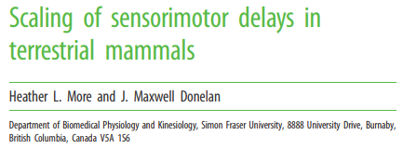
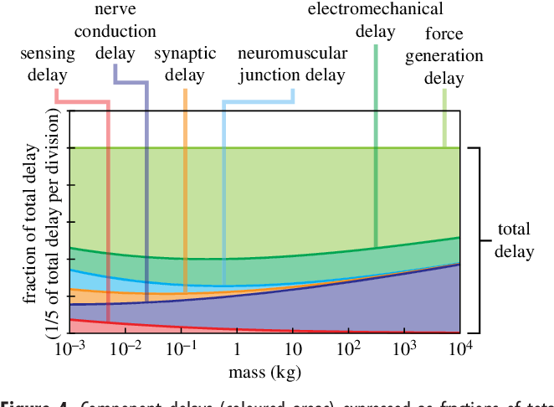
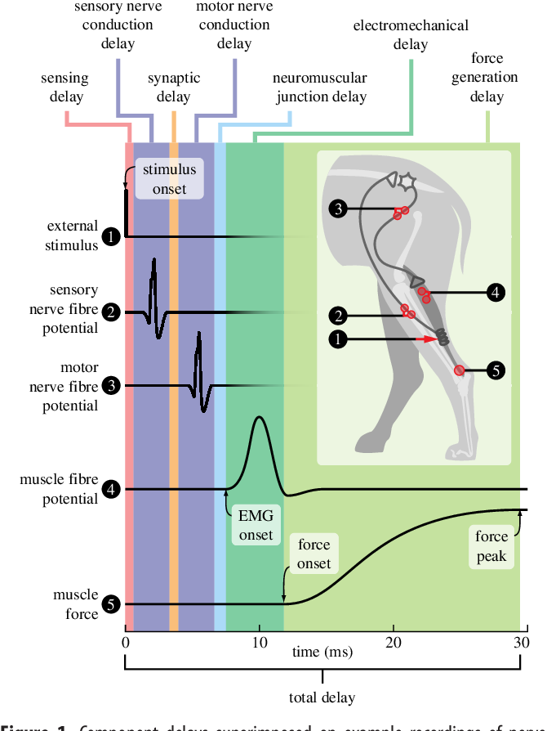
Large mammals experience total delays ~17 times longer than smaller mammals (in control)
Large mammals have longer to respond however, the movement duration scales only with the square root of limb length
Why not have shorter delays for larger mammals given how important it is??
This would require increased energy, fewer nerve fibers in a nerve and thus reduction in the precision at which animals can sense and respond to stimuli
In order to deal with this, the locomotion speed of the mammal decreases with size
Another solution is to predict the best future motor response. This is only a useful strategy for large animals in which the synaptic delays associated with neural computation are short relative to movement durations

Slide 10
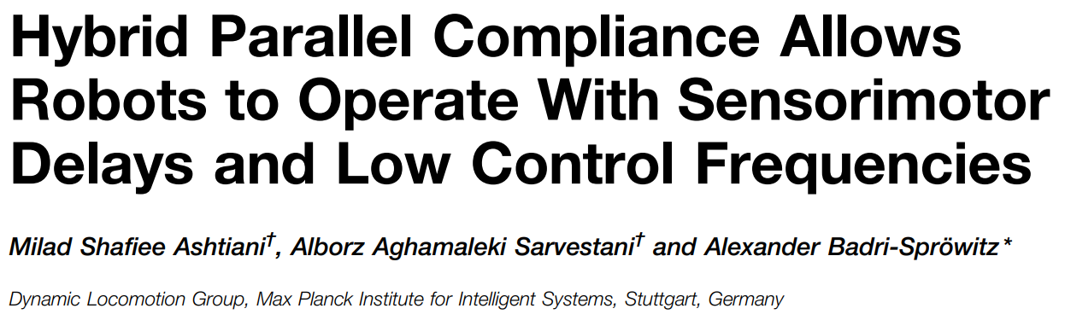
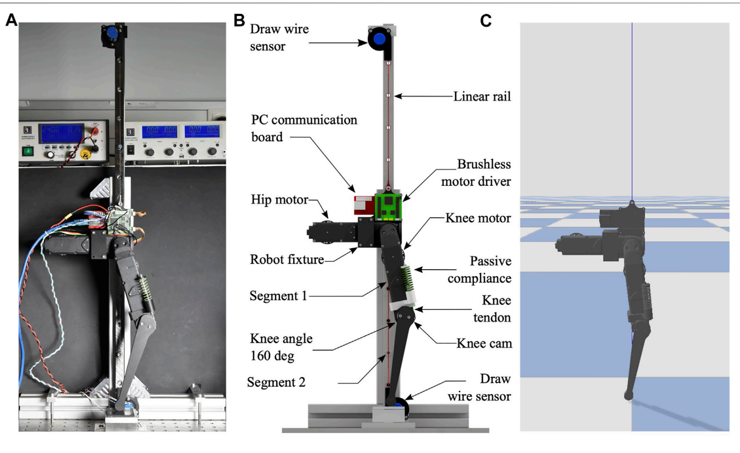
2021
Larger animals have:
Higher communication delays
Faster speeds wrt response times
Thus, in order to deal with this, biology has adapted passive control like:
Passive muscle properties (spring like)
Reflexes like the stretch reflex
When implementing this in an artificial limb allows:
Sensorimotor delay of upto 60ms
Control frequencies as low as 20Hz = command every 50ms

